Slide 1
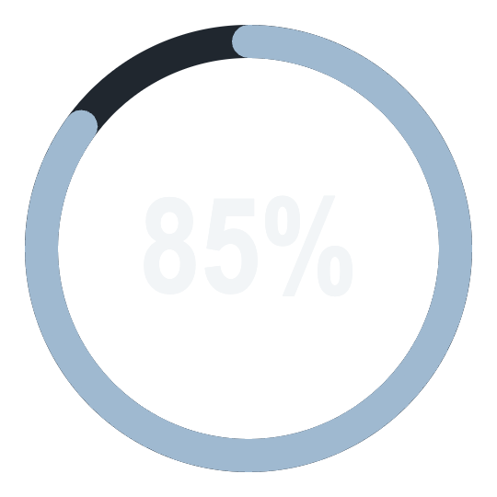
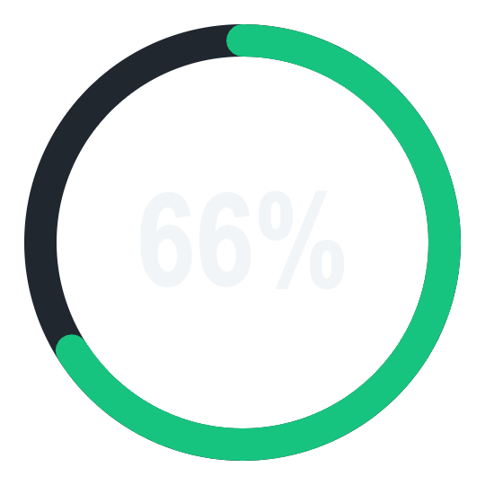
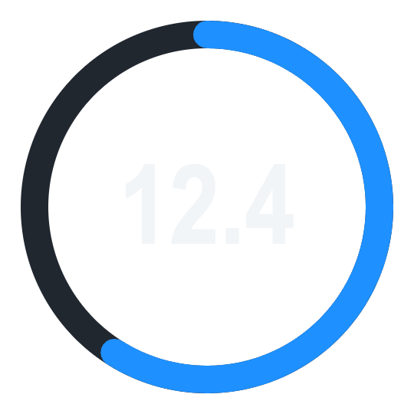
Vitalis
HACKACHUSETTS 26
See how what you eat, when you eat, and how you train shape your daily recovery.
SLEEP
RECOVERY
STRAIN
[Team name] · [Team members]
Notes:
Introduce the team and the name, Vitalis. One line: Vitalis connects food and exercise timing to your daily recovery.

Slide 2
The gap in everyday recovery
Exercise: covered
Recovery: covered
Food: missing
WHOOP already tracks your workouts, strain and heart rate.
It scores your recovery, sleep and HRV every morning.
What you eat and when you eat it never reaches your recovery picture.
Your recovery score can't tell you which meals, or which meal times, are helping or hurting.
Notes:
The gap: wearables already cover exercise and recovery. Food, the part you control every day, is missing from the picture.

Slide 3

Our idea: connect food and training to recovery
Food
What you eat and what time you eat it
Report
→
→
What helps you recover, and suggestions to get fitter
Exercise
What you do and what time you do it
DAILY RECOVERY
Food is the missing input. We add it to the exercise data WHOOP already gives.
Notes:
Walk the flow left to right: food and exercise, with timing, feed into daily recovery, and the app turns that into a report with suggestions.

Slide 4
What we built
Dashboard
Food scan
Connected data
Report engine
Recovery, strain and sleep rings in a WHOOP-style app.
Scan a meal to log what you ate and when.
Demo data in WHOOP's format feeds every screen.
Logic that links meals and workouts to recovery and writes suggestions.
Because the data mirrors WHOOP's, the same app works on a real WHOOP feed.
Notes:
Describe what is working today: the dashboard, the food scan, the connected data layer and the report and suggestion logic.

Slide 5
From meal scan to suggestion
1 Scan
2 Identify
3 Align
4 Analyze
5 Suggest
Photo of your meal, with the time logged.
Foods and their nutrition are recognized.
Meals and workouts matched to each day's recovery.
Patterns in food choices and timing.
A report on what to change.
Every day is lined up on WHOOP's wake-to-wake cycle, so dinner meets the next morning's recovery.
Notes:
The logic behind the app. Stress the alignment: recovery on a morning reflects the previous day's meals and workouts.

Slide 6
The report: what helps and what hurts
Meal timing
How dinner and snack times line up with recovery.
EXAMPLE SUGGESTIONS
● Keep protein-rich dinners on training days
Food choices
Which meals come before your best mornings.
● Move late workouts earlier in the day
● Leave more time between dinner and bed
Workout timing
When you train and how that affects recovery.
Notes:
The report turns the daily log into a plain-language summary and suggestions. The suggestions on this slide are examples of the kind of advice it gives.

Slide 7
Know what to eat, when to train, and how it shapes your recovery.
VITALIS
Food: what you eat and when
Exercise: what you do and when
Recovery: your daily result
[Team name] · [Team members] · Thank you
Notes:
Close with the one-line promise, thank the judges and invite questions.

